Slide 1

Sentiment Analysis
Narendra Visai(fl3008)
Niranjan Jadhav(fr9238)

Slide 2
Acknowledgment
We are thankful towards Dr. Kotov for guiding us for the project by giving valuable suggestions and giving us a free hand to work on our choice of project.
Also, for providing us with helpful resources to learn Python, sentiment analysis etc.

Slide 3
Why Sentiment Analysis?
Get insights of the people’s emotions about certain subjects.
Handling large scales of data manually is next to impossible.
So, a lot of money and time spent doing all these tasks manually.
Therefore, automate the process.

Slide 4
What is Sentiment Analysis?
Sentiment analysis is detection of attitudes.
“Displaying the affectively colored beliefs towards a person, object etc.”
In simple words, it is the task that identifies any text to be positive or negative.
E.g. ‘I like your shirt.’
‘This is disgusting.’

Slide 5
Applications
Products: What do people think about the new iPad?
Politics: What do people think about the candidate?
Movies: is this review positive or negative?
Prediction: Predict market trends, election outcomes from sentiments

Slide 6
Problem Statement
To train a system to classify a given movie review as ‘Positive’ or ‘Negative’ based on the text used in the review.
To increase the accuracy of the classifier over the time.

Slide 7
Data Used
We are using movie review sentence polarity dataset v1.0 from
http://www.cs.cornell.edu/people/pabo/movie-review-data/
This dataset has already classified positive and negative reviews.
It contains 5331 positive and 5331 negative reviews.

Slide 8
Let’s start with ground work!
Language- Python
Tools- NLTK
Incredible library for python
can do huge amount of text processing and analysis
forms basis for the program

Slide 9
Flow of program
Get the reviews by reading dataset file.
Extract the features (words).
Remove punctuation marks.
Remove the stopwords.
words with length less than 3.
Apply Stemming.
Generate test set and training set.
Apply Naïve-Bayes classifier from NLTK to train our program.
Find the most informative words by using feature selection mechanism and use them to classify the review.
Calculate accuracy, precision and recall.

Slide 10
Feature Extraction
What is feature extraction?
Transforming huge, redundant data into reduced representation.
If the features are extracted carefully it is expected that the features set will extract the relevant information from the input data.
Remove the punctuation marks.
Remove the stopwords (eg: a, is, the, was).
Remove the words with length less than 3.
We store the positive and negative words in two separate files, based on the predefined polarity.

Slide 11
Train set and Test set
The training set is 75% of the whole dataset.
The test set is 25% (obviously) of the whole dataset.
Advantages of using larger training set as compared to test set.

Slide 12
Naïve-Bayes algorithm
A naive Bayes classifier assumes that the presence (or absence) of a particular feature of a class is unrelated to the presence (or absence) of any other feature.
An advantage of naive Bayes is that it only requires a small amount of training data to estimate the parameters necessary for classification.

Slide 13
Apply Naïve-Bayes algorithm
Input will be given as training set to our classifier.
This will train our classifier and it is now more intelligent.
Now we can apply our trained classifier to test the sentiment of reviews.

Slide 14
What is:
Precision:
It measures the exactness of a classifier. A higher precision means less false positives while a lower precision means more false positives.
Recall:
Recall measures the completeness, or sensitivity, of a classifier. Higher recall means less false negatives, while lower recall means more false negatives.

Slide 15
Calculating Accuracy, Precision and Recall
In order to know how accurate our classifier is, we compare the reference set and prediction set.
Reference Sets will contain the actual values for the testing data.
Test Sets will contain the predicted output by our classifier.
Using ‘metrics’ package and above two sets, we calculate accuracy, precision and recall.

Slide 16
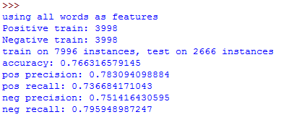
Sample output
The following is the output showing accuracy, precision and recall.

Slide 17
Feature Selection mechanism
This basically means the way we select which words to train the classifier on.
We look at the individual words themselves rather than just counting positive and negative words.
We are creating a dictionary object which will hold all the words in the review.

Slide 18
Most Informative features
We build frequency distribution of all words and then conditional frequency distributions of words within positive and negative labels.
Then, find the number of positive and negative words, as well as the total number of words.
Now, we build dictionary of extracted words.

Slide 19
Assigning the scores
To find the highest information features, we need to calculate the information gain of each word.
A word that occurs primarily in positive movie reviews, rarely occurs in negative ones and this is high information.
We use BigramAssocMeasures class in metrics package.
Using values of Frequency Distribution and Conditional frequency distribution we calculate scores with chi_sq function.

Slide 20
Continued..
Then we sort all the words by their score. (e.g. n=10,100,1000, 10k, 15k)
Then use feature selection function to select only the words, present in the above set.
Now, we classify each file based on the presence of high information words.

Slide 21
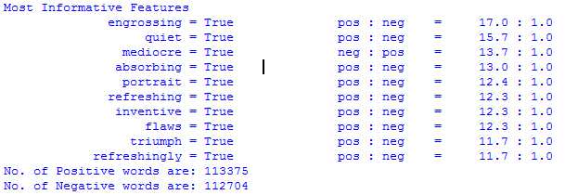
Sample Output

Slide 22
Meaning of the output
Here, ‘engrossing’ has a ratio of 17:1, which means that when ‘engrossing appears in the review, then there is a 17:1 chance that the review is positive.
We can observe the word ‘flaws’ with positive ratio 12.3:1. This is because, people rarely use this word in negative sense.
E.g. ‘It has a few flaws, but…’

Slide 23
Conclusion
Feature Extraction | Accuracy | No. of High Informative words
With stopwords | 0.5645 | 10
w/o stopwords | 0.5555 | 10
With stopwords | 0.6372 | 100
w/o stopwords | 0.6612 | 100
With stopwords | 0.7179 | 1000
w/o stopwords | 0.7839 | 1000
With stopwords | 0.7636 | 10000
w/o stopwords | 0.8477 | 10000
With stopwords | 0.7716 | 15000
w/o stopwords | 0.8459 | 15000

Slide 24
References
‘Baselines and Bigrams: Simple, Good sentiment and topic classification’, Sida Wang, Chris D. Manning.
‘Sentiment Analysis of Movie reviews’, Kuber Kaul, Dragomir R. Radev.
Python Cookbook, 3rd Edition, O'reilly media.

